Slide 1
CULTERAL DIVERSITY PILOT:
Westminster & Eagle Heights
Partnership with VON-OSNP, GrowingChefs! Ontario, and TCDSB

Slide 2
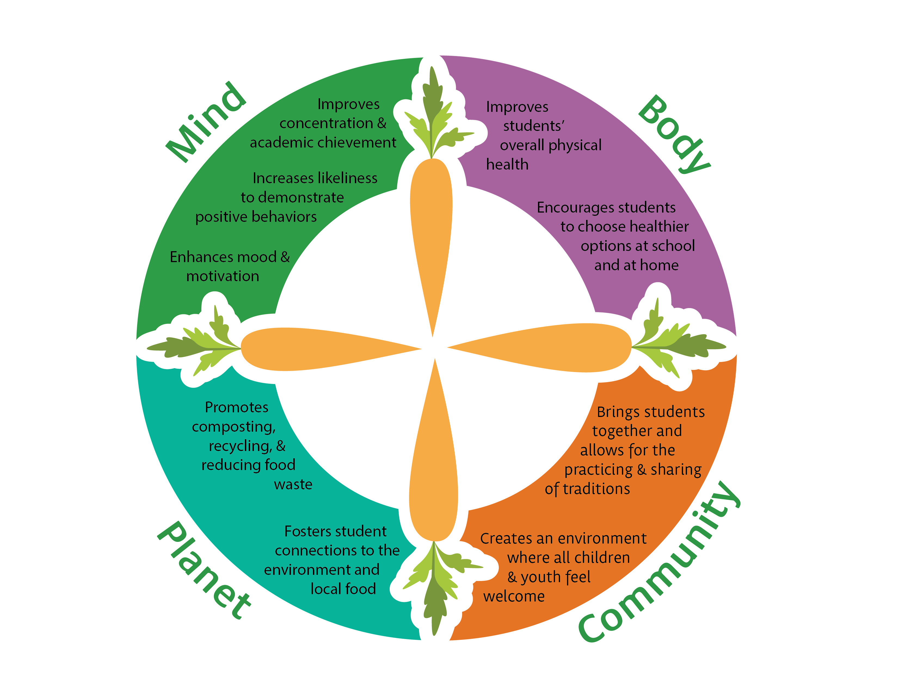
Cultural Diversity Pilot: What
Providing culturally diverse menu items for our OSNP schools which is in alignment with our equity and inclusion framework, ensuring that all students feel represented in our programming, regardless of faith or culture.
Our goals are:
inclusion of those students with lived experience from the respective culture of celebration with their peers and school community
engaging in new dynamic partnerships in the community in development of these baked goods.

Slide 3
Cultural Diversity Pilot: Who
Food Literacy, Kitchen & Chefs
Growing Chefs Ontario, a food literacy and education non-profit organization, provides the recipe development in collaboration with a chef’s (native to or with lived experience) the baked good is designed to celebrate.
Currently we are piloting this culturally diverse baked good with two schools which are in the TVDSB. The schools selected at the TVDSB have been verified by the equity and inclusion education coordinator at the elementary and secondary level as largely diverse and multicultural.
Student Population
In the 2022.23 school year, we served 2000 students’ total
1100 elementary: Eagle Heights
900 secondary: Westminster

Slide 4
Cultural Diversity Pilot: When
FEBRUARY
Black History Month:
Daakwa
APRIL
Eid al-Fitr:
Barazak
JUNE
Indigenous Peoples Day:
Wild rice and strawberry muffin

Slide 5
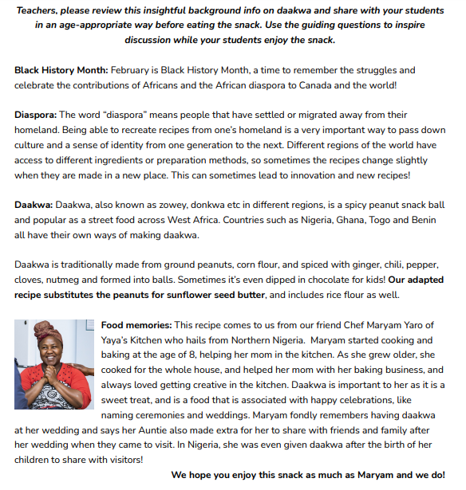
Cultural Diversity Pilot: Literacy
Growing Chefs and the respective native chef have established a literacy document that can be tailored from JK to grade 12 which is designed to provide education and engagement around the baked good provided.
This resource includes, but is not limited to, information about the culture, the native chef, and the ingredients to recreate this recipe at home!

Slide 6
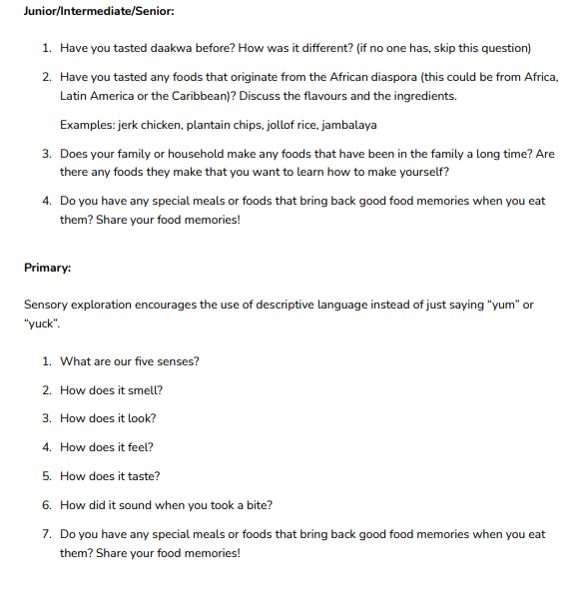
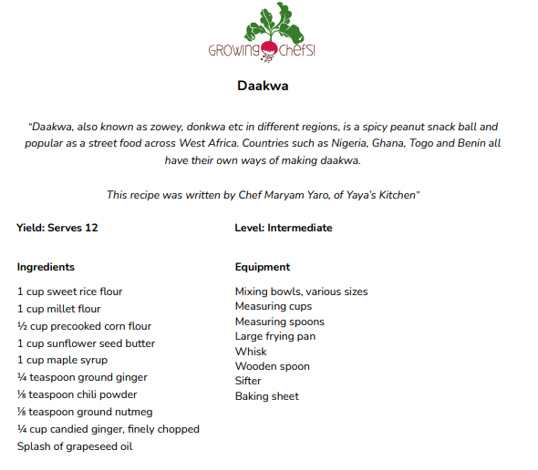

Slide 7
Cultural Diversity Pilot: Outcomes
Measured Outcomes: collected by Google Form with consent from TVDSB
QUESTIONS:
Did you enjoy the food items you ate? (Y/N)
What did you like or dislike about the food items you are?
What is something new you learned about the culture associated with today’s food item?
Are there any other cultural foods you would like to see served?

Slide 8
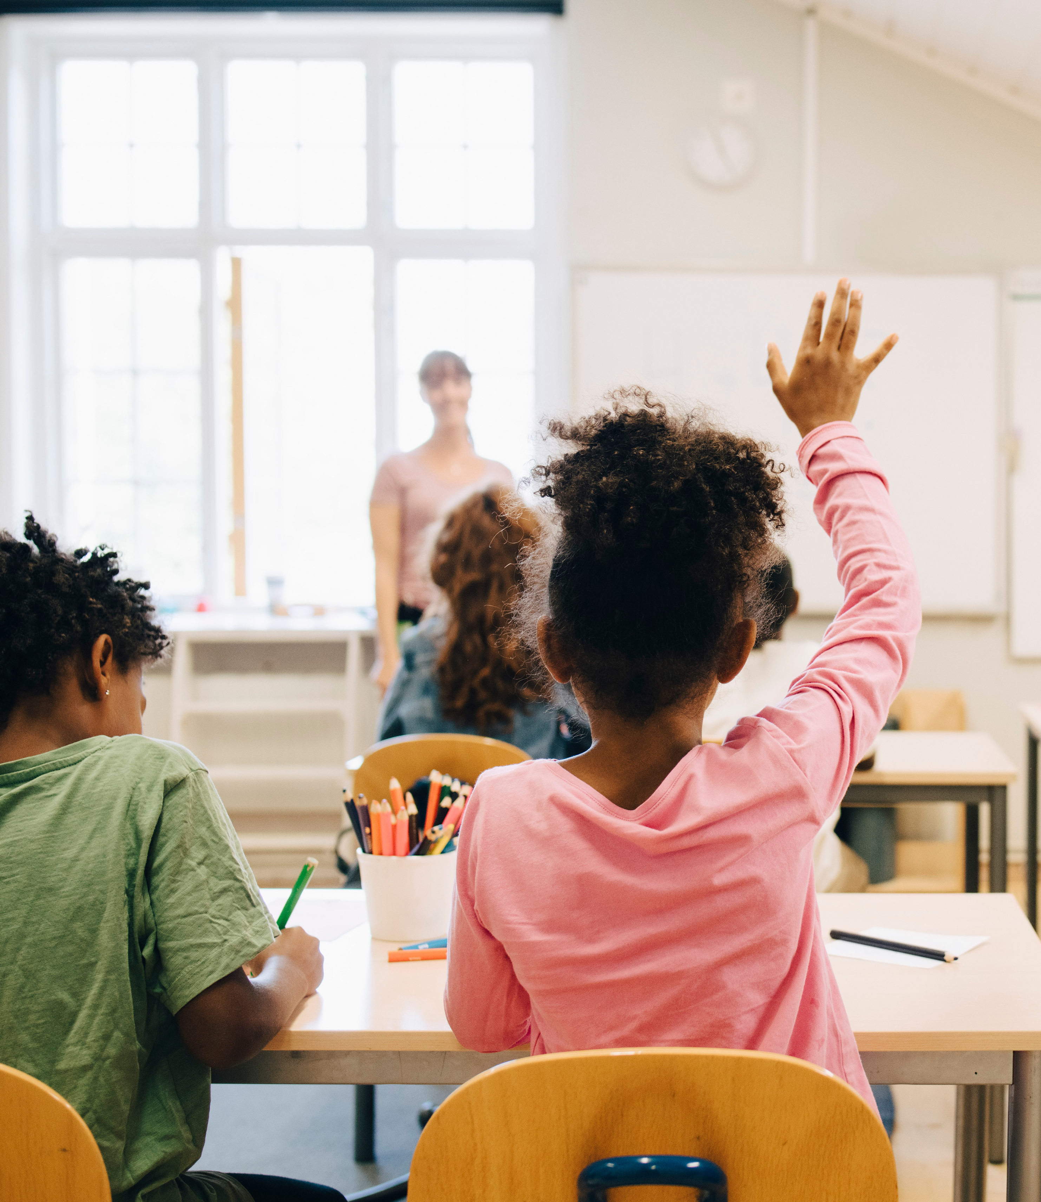
Identifying Areas of Improvement
Literacy Document Wish List
Age appropriate explanations (words and concepts)
Understanding the goal of the project → lessons on nutrition vs. food memories and experiences

Slide 9
Black History Month
“A couple of students came to me in the afternoon looking for more baked goods. One student said his grandmother used to make them and it reminded him of home. I sent him home with a container for his family to enjoy. He also insisted that his whole class try them, so I took a bag over and we passed them out for everyone to try.” - Westminster SNP coordinator
“The students I spoke to really enjoyed this experience. They were able to describe the new taste and did so in positive ways (like a spicy gingerbread cookie!). Last night I heard from a kindergarten teacher about how proud she was of all of her students as everyone tried the snack! She even went so far as to find a video of the treat being made and the children enjoyed seeing the process.” -Eagle Heights SNP Coordinator
$75 minimum order
Order deadline: Wednesday at 11:59pm for delivery the following week
Notes:
7:45-8:30 am on Tuesday Feb 28th (about 200 came by- busses delayed)
Would be sent out to classrooms after this time – info on this from Laurie after
Overheard:
- kids guessing what it was made of before they looked at recipe - some even guessed sunflower seeds!
-a few mentioned they have tasted something like this before
-“too sweet for the morning”
-“Nigerian timbits”
-“tastes like a paste”
Saw:
-kids gathered around to look at what these were before eating
-asking each other if they liked it or what it was like
- mix of staff and students trying it
-leadership class was handing out with tongs- some passively some approaching students
-a few students walked halls to talk about it and there was a loudspeaker set up
Set up- 2 long tables with QR code displayed- handout printed so students could grab them

Slide 10
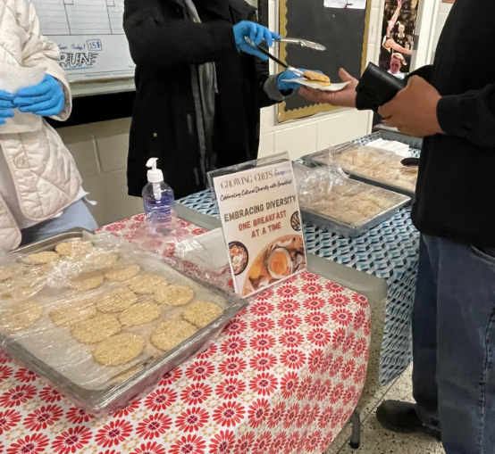
Eid
LESSONS LEARNED:
What does celebration truly mean? (treats vs. appreciation)
Excitement fatigue – timing of event
Notes:
NEED this info from emails…

Slide 11
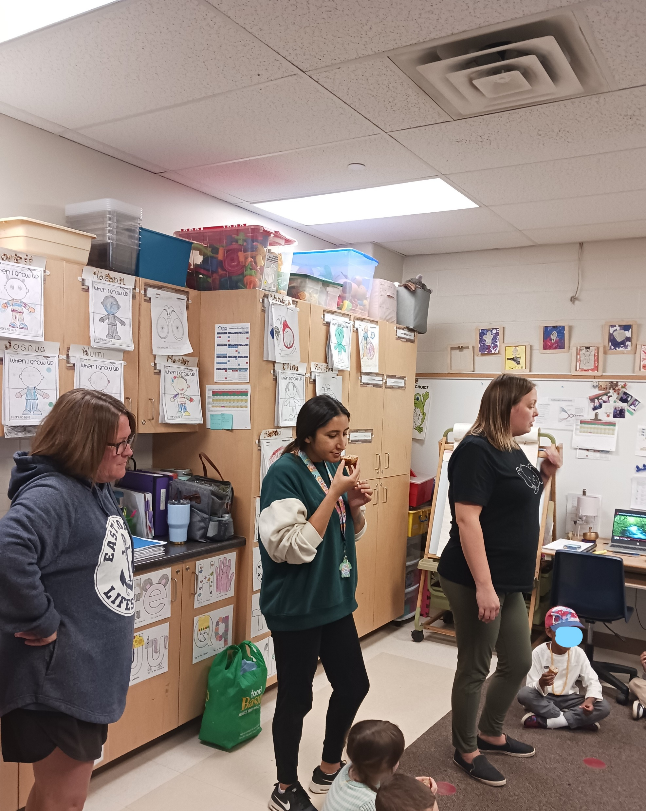
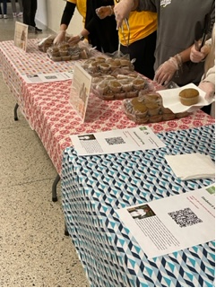
Indigenous History Month
Notes:
Westminster- The muffins were a success 🙂. The students seemed to like the muffins. I liked that they came in a muffin wrapper. This made them very easy to serve. We had napkins available for those that wanted one, but most students just took the muffin that they were offered making it easy serving. The muffins came in bigger bags so we could easily store the leftovers to give out and there were no containers to pack up. We gave out muffins at Breakfast Club the next morning and then wrapped what was left to put out at our serving sites. At the library I just plated them a few at a time so they were easy to grab and go. We also had students going off-site for the Special Olympics and it was convenient to send a couple of bags for snacks for our students and student helpers. I feel like the muffins seemed like a breakfast item to students, so they were a little better received. A few kids said they didn't like them, but overall, most of the feedback was positive.
Eagle Heights: The teacher set the stage by having the students guess what they were going to eat based off what they looked like on the counter. The students then got into a circle while the teacher read and engaged with the literacy resource provided. The JK/SK class participated with smiles on their face, some students vocalizing they LOVED it or that they didn’t enjoy mushy strawberries. This turned into discussion on how food changes texture and form when cooked. Food science lesson you could even say !
I would personally say that I was extremely impressed with the level of interest and excitement from both students AND teachers/ support staff. The staff mentioned having ample discussion and transparency about what they were about to eat sparked curiosity and encouraged a willingness to try something they may not have otherwise tried. The 4/5 year old’s sat SO patiently !
If I could have recorded it I would have because it was so tender yet earnest to watch and see the level of interest and appreciation from this group.

Slide 12
Storytelling and Experiencing
Exploration with peers = greater chance of engagement and willingness to try new things ( both in JK class and in halls of SS)
Connection emotionally is HUGE for formation of something that is not familiar ex/ if you are not Nigerian and you hear the word Daakwa you have no relationship to this “thing” BUT if you hear a story of excitement anticipating a food that signifies joy and love, you would be more willing to try (adults included!)

Slide 13
Takeaways and Next Steps
Resource can be used for years to come in schools and family settings
Storytelling is EVERYTHING
Students preferred a “breakfast” item of cultural significance vs. a treat
Next steps:
with what is already developed – open it to all schools with the resonation of resource
Secure funding for this to continue to grow .. More schools/ boards/cultural events
Findings from students- suggestions of other celebrations … being ______

Slide 14
THANK YOU TO:
GrowingChefs! Ontario
Yaya’s Kitchen
Aoush Mseitef
Shawn Dockstader
Thames Valley District School Board

