Slide 1
Section 3: Food and Beverage Choice: Based on the Eat Well Plate from the CFG
https://nutritionconnections.ca/wp-content/uploads/2020/09/SNP-Nutrition-Guidelines-2020.pdf

Slide 2
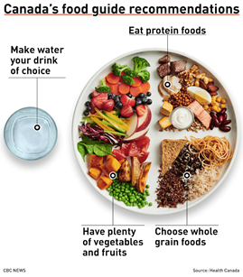
Categories: Vegetables and fruits, whole grain foods, protein foods
Food choices are categorized as “serve” or “do not serve” in these tables.
There is also a table for “minor ingredients”, which are foods that do not fit on the Eat Well Plate.
Notes:
The categories in the 2020 nutrition guidelines are based off of the CFG recommendations
They include Fruits and vegetables, whole grains and protein foods
The 2020 nutrition guidelines follows these recommendations and has also categorized this further into serve or do not serve

Slide 3
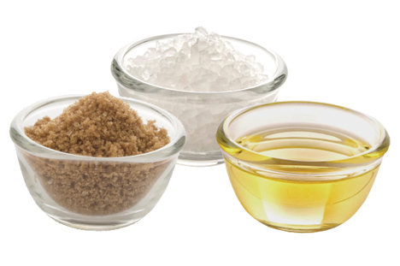
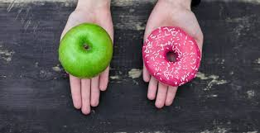
Understanding “serve” and “do not serve” Food and Beverages Pg 6
Serve
Do not serve
Have lower amounts of added sugar, salt and saturated fat.
They are good sources of nutrients such as fibre, calcium and iron.
Are minimally processed.
Can be served at all meals and snacks
Align with recommendations in CFG.
Are safe to consume.
Have higher amounts of added sugar and/or salt.
They contain unhealthy fats and/or small amounts of nutrients such as fibre, calcium and iron.
Are highly processed.
Should not be offered in SNPs. • Do not align with recommendations in CFG.
May not be safe to consume (e.g. raw fish, sprouts or unpasteurized dairy).
Notes:
How can we better understand the serve and do not serve categories ?
Serve items are low in sugar, salt and fat, good sources of nutrients, minimally processed ( encouraging whole foods when possible, They can be served at all meals and snacks and are safe to consume
Do not serve contain higher amounts of sugar, salt and fat, contain little or no nutrients, highly processed ( generally with a lengthy ingredients list), and may not be safe – for example unpasteurized so there may be risk of harmful bacteria growth, or raw foods like homemade mayonnaise with raw eggs
Note: The food and beverage choice tables are not complete lists. If you have a question about an item that is not on the list, contact your lead agency or local public health unit.

Slide 4
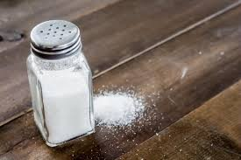
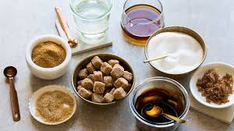
How to use the food and beverage choice tables: Most packaged foods and beverages have a food label.
CFG recommends having less sodium.
Bread products, cereals, packaged snacks and processed meats, etc. can have a lot of sodium. Look for foods and beverages with less than or equal to 10%DV (daily value) of sodium to serve in your SNP. •
CFG recommends choosing foods and beverages with less added sugar.
Items such as bakery products, sweetened cereals, packaged snacks and flavoured yogurts can have a lot of added sugar.
Notes:
How can you use the food and beverage choice tables? By reading and understanding the nutrition label shown here on the left.
Foods such as fresh vegetables and fruits do not have food labels because they have nothing added to them. They are the only ingredient.
All fresh vegetables and fruits are found in the serve category of the food and beverage choice tables (except for raw sprouts, for food safety reasons). • Information in the nutrition facts table is based on a quantity called serving size. It is listed at the top of the table.
The serving size tells you the amount of food used to calculate the numbers in the nutrition facts table. It may or may not be the amount that you choose to serve in your SNP. •
The %DV (daily value) shows how much (or how little) of a nutrient is in a food or beverage. 5%DV or less means there is a little of a nutrient and 15%DV or more means there is a lot of a nutrient in the food or beverage %DV is found on the righthand side of the nutrition facts table.
As you can see here, the CFG recommends having less sodium and less added sugar

Slide 5
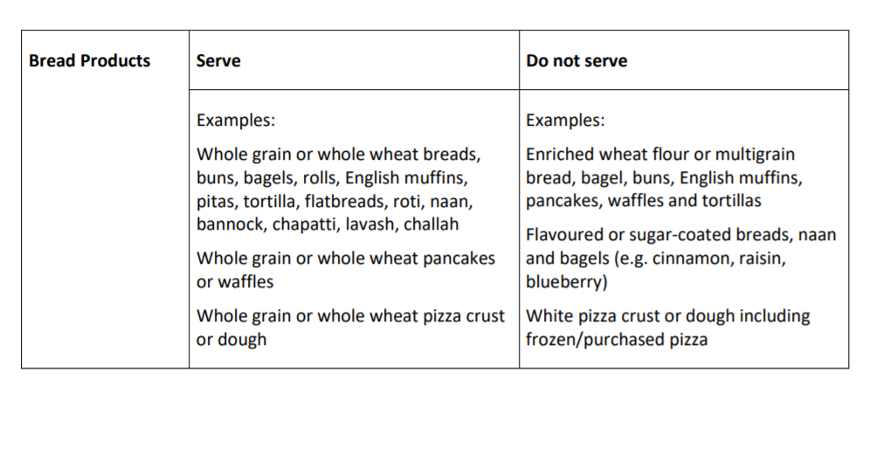
Highlighting each categories main focus
The following slides include the primary focus for selection with some examples from each category
For more examples please refer to the PDF page ( in title) and section – link to the PDF online is included at the bottom of each slide
2020 Nutrition Guidelines PDF
Notes:
The following slides include the primary focus for selection with some examples from each category
For more examples please refer to the PDF page ( in title) – The link to the PDF is included at the bottom of each slide You can click on this to access the complete 2020 nutrition guideline
The chart shown here is an example of what you will find included in the 2020 nutrition guideline PDF

Slide 6
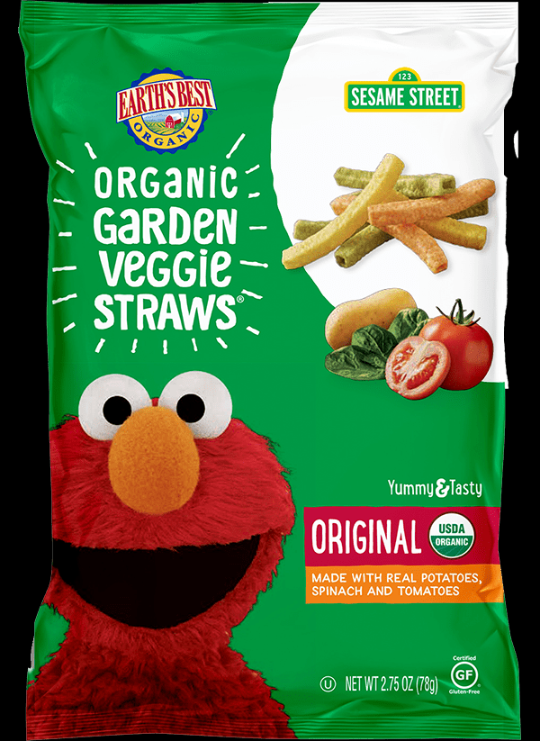
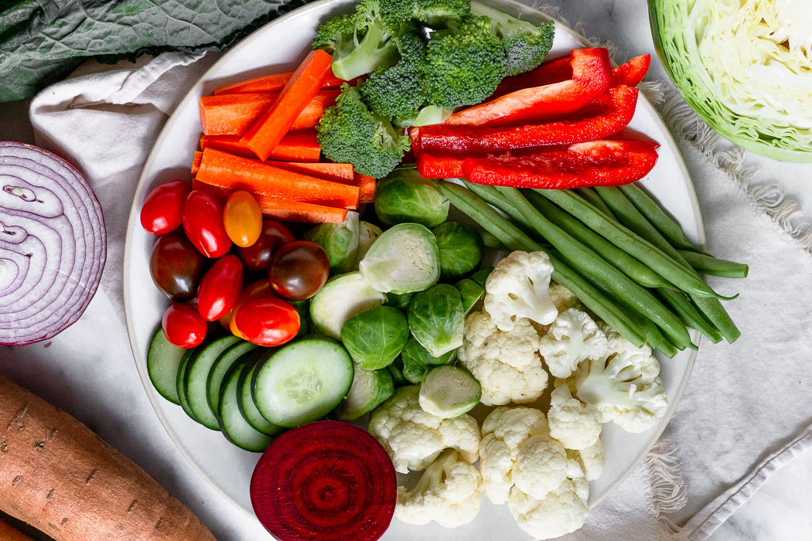
Vegetables PDF: page 9
Serve
Do Not Serve
Fresh and Frozen vegetables
Canned products with sodium less than or equal to 10% DV (daily value) per serving
Vegetable juice, including 100% juice
Packaged potato products (e.g. potato wedges)
Vegetable chips
2020 Nutrition Guidelines PDF
Notes:
Vegetable category – found on page 9
When it comes to serve selection pick fresh or frozen items and ensure canned products contain 10% or less of the daily intake of sodium per serving
Do not serve foods that are highly processed like veggie straws or chips- as they generally contain added oils, and higher salt

Slide 7
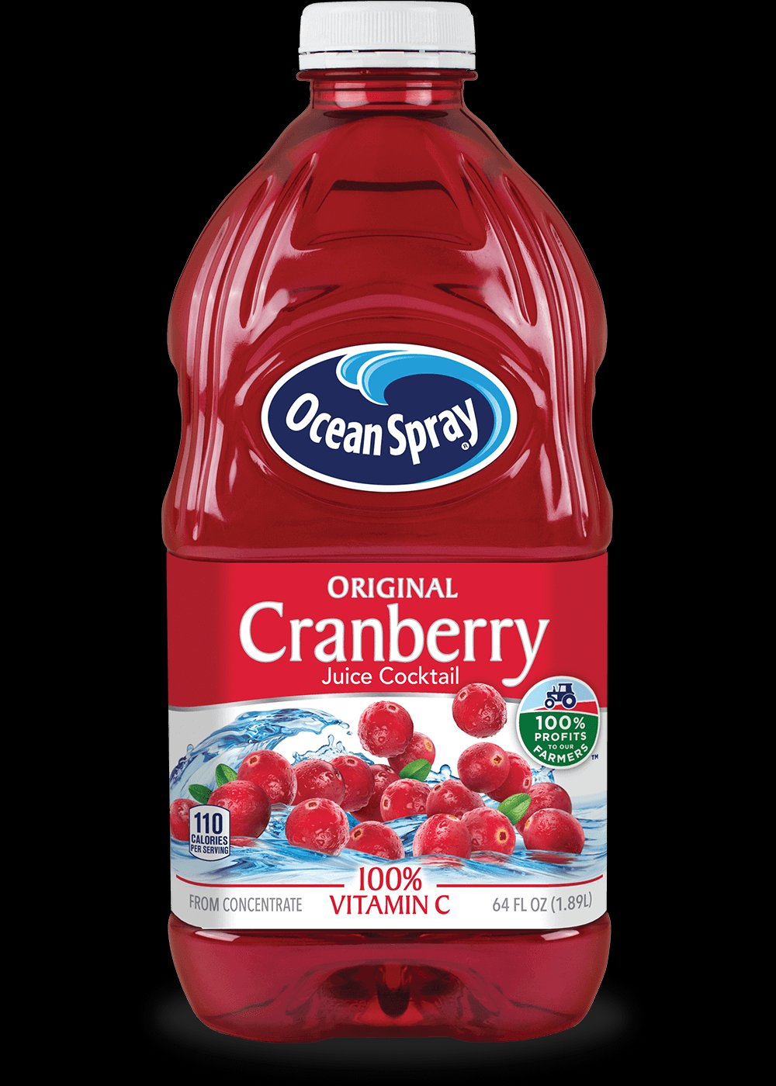
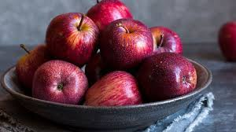
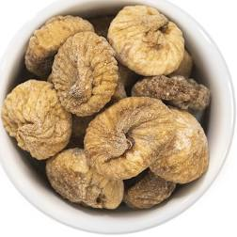
Fruits: PDF: Page 9
Serve
Do not Serve
Fresh fruits, frozen and canned fruits with no added sugar
Unsweetened applesauce or fruit purées
Dried fruit with no added sugar**
Fruit juice, including drinks such as fruit beverages, punches, cocktails
Processed fruit products with added sugar:
Ex/ Fruit leathers, fruit chips or fruit flavoured rolls
2020 Nutrition Guidelines PDF
Notes:
Fruit selection – found on page 9
Fresh , frozen and canned fruits are all wonderful choices
Make sure that the canned or pureed selection contains no added sugar
When it comes to foods and beverages to not serve, fruit juices are now not recommended as they remove nutrition like fibre and contain a concentrated source of sugar- even though it is naturally occurring

Slide 8
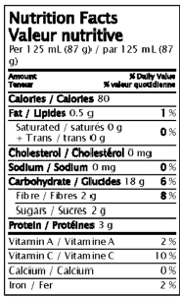
Whole Grains: Breads, Cereals, Baked Goods, Snacks etc
Guidelines:
Whole grain, whole wheat or bran is first on the ingredient list
AND
Sodium is less than or equal to 10% DV (daily value) per serving
AND
Sugar is less than or equal to 8 grams per 30 gram serving
2020 Nutrition Guidelines PDF
Notes:
Understanding the nutrition label in regards to whole grain products like breads and baked goods.
Whole grain, whole wheat or bran is first on the ingredient list
AND
Sodium is less than or equal to 10% DV (daily value) per serving
AND
Sugar is less than or equal to 8 grams per 30 gram serving

Slide 9
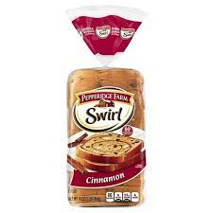
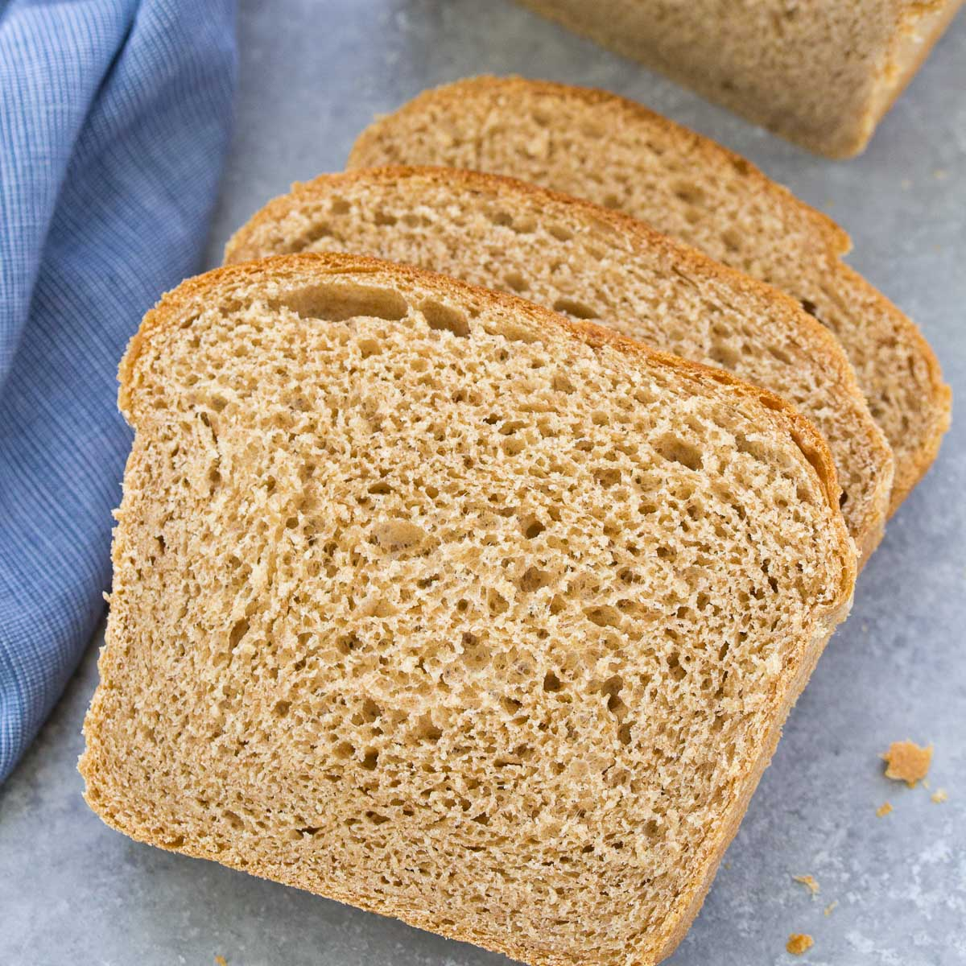
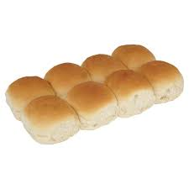
Bread Products- PDF: Page 10
Serve
Do Not Serve
Whole grain or whole wheat breads, buns, bagels, rolls etc.
Whole grain or whole wheat pancakes or waffles
Enriched wheat flour or multigrain bread, bagel, buns etc
Flavoured or sugar-coated breads, naan and bagels (e.g. cinnamon, raisin, blueberry)
2020 Nutrition Guidelines PDF
Notes:
Bread Products found on page 10
Serve whole grain items
Do not serve enriched, flavored or white flour breads – as they are highly processed and generally contain higher amounts of sugar and salt

Slide 10
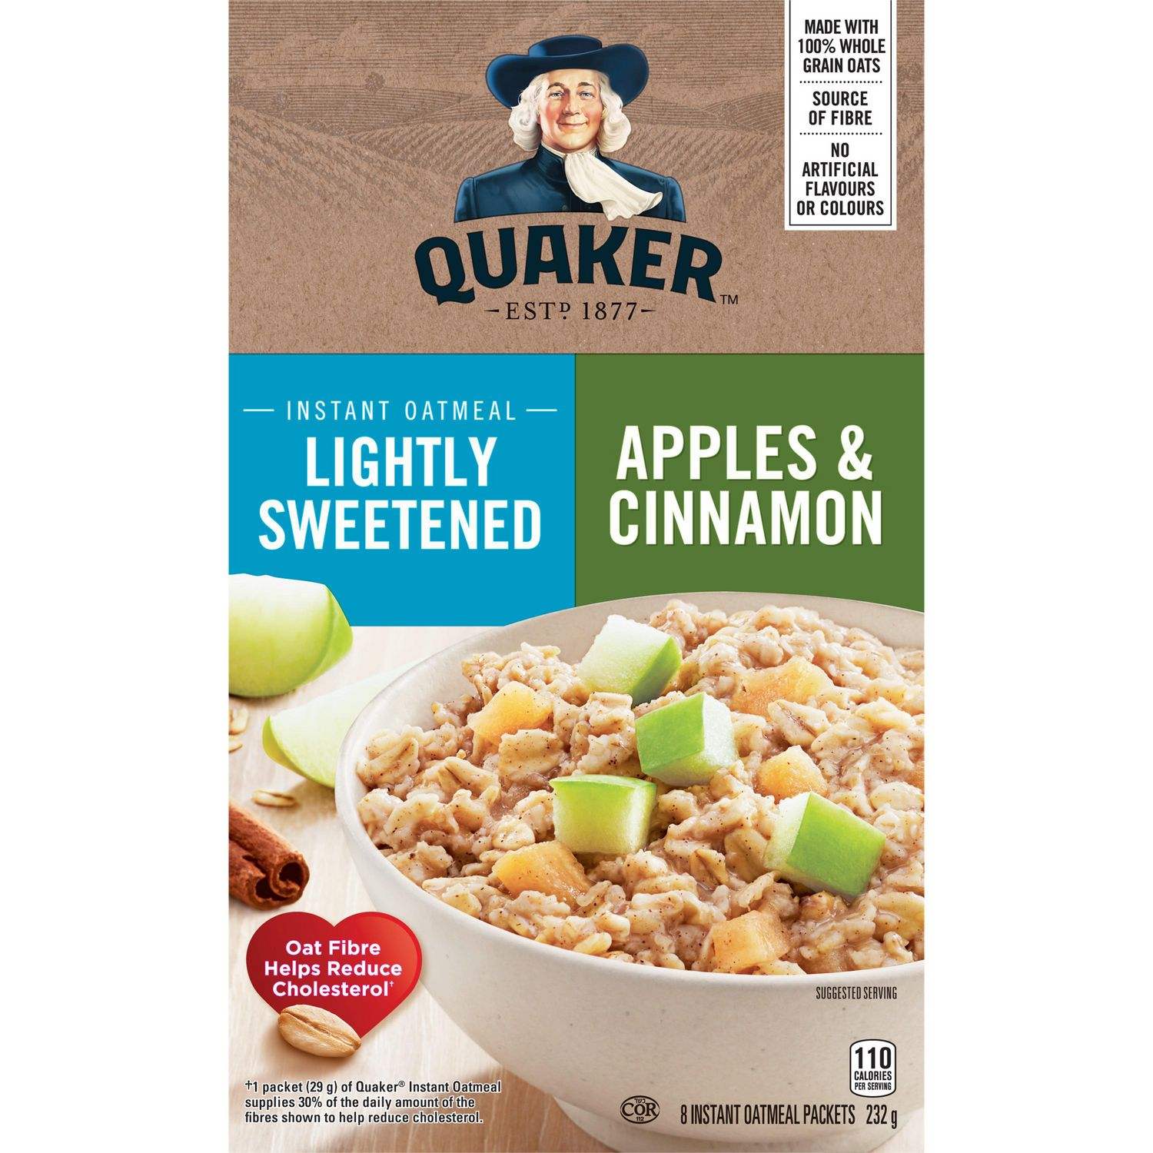
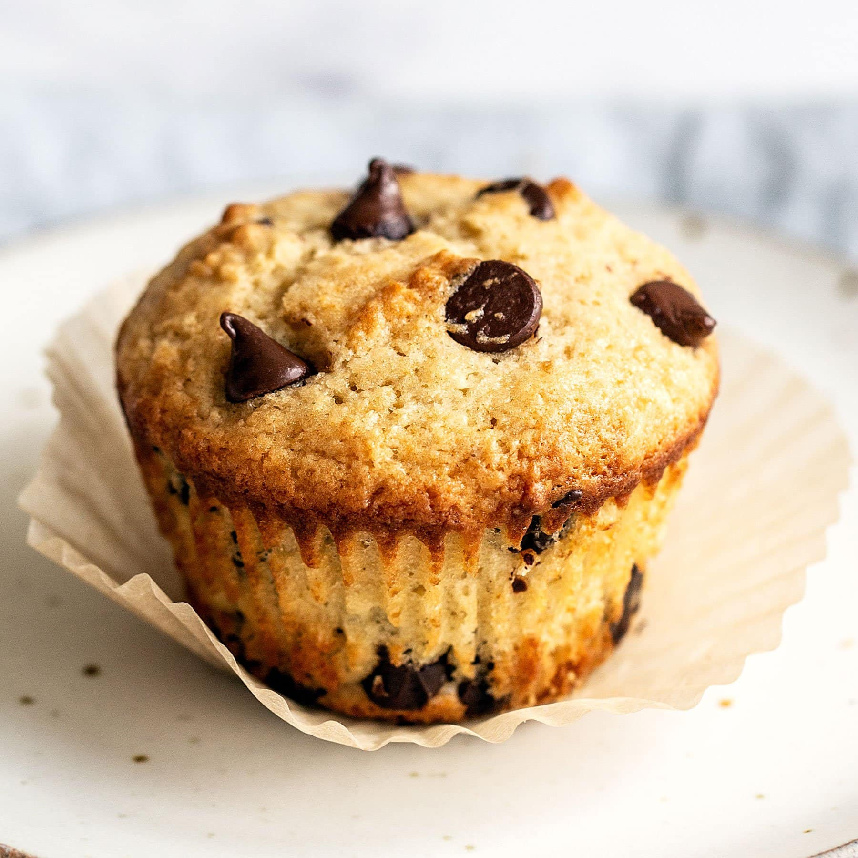
Cereal and Baked Goods- PDF: Page 11
Serve
Do Not Serve
Oatmeal (e.g. quick cooking or large flake)
Oatmeal, instant (lightly sweetened)
Whole grain cereals, muffins and scones
Cereal with chocolate, candies, marshmallows or sugar-coated pieces
Oatmeal, instant (regularly sweetened)
2020 Nutrition Guidelines PDF
Notes:
Cereal and baked goods found on page 11
Serve natural or lightly sweetened oats and whole grain cereal and muffins
Do not serve items with chocolate, candies as these contain added sugar

Slide 11
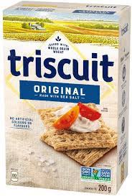
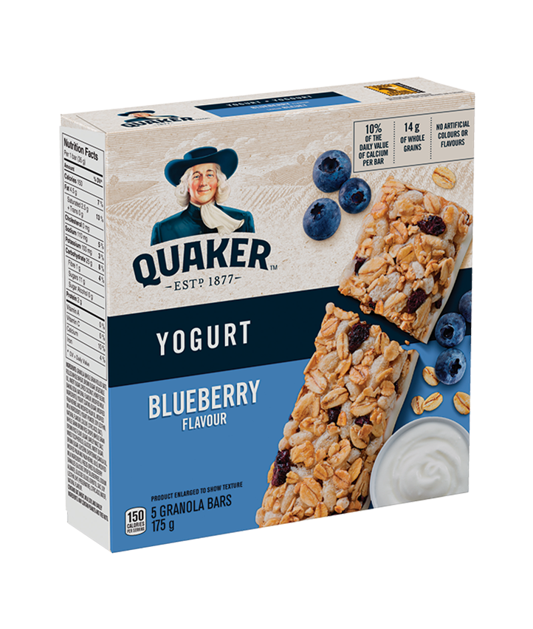
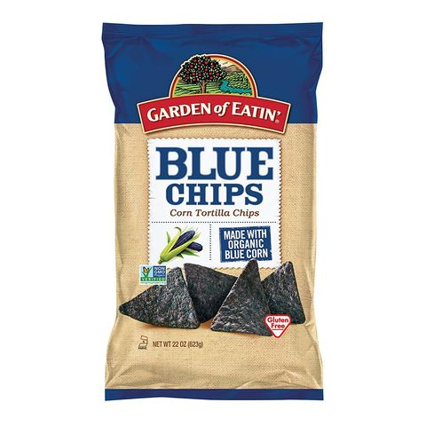
Grain Based Snacks- PDF: Page 11
Serve
Do Not Serve
Whole grain granola or cereal-type bars
Whole grain crackers
Brown rice cakes, unflavoured and unsweetened
Chocolate or yogurt dipped granola or cereal-type bars or those containing marshmallows, candy or chocolate pieces
Pretzels, tortilla or pita chips
2020 Nutrition Guidelines PDF
Notes:
Grain based snacks found on page 11
The goal here is to serve whole grain items like granola, or unsweetened, unflavoured brown rice cakes
Do not serve items that are dipped in yogurt or chocolate as they contain added sugar even though they may be use whole grain
Items like pretzels and pita chips are highly processed and generally contain higher amounts of sodium and fat

Slide 12
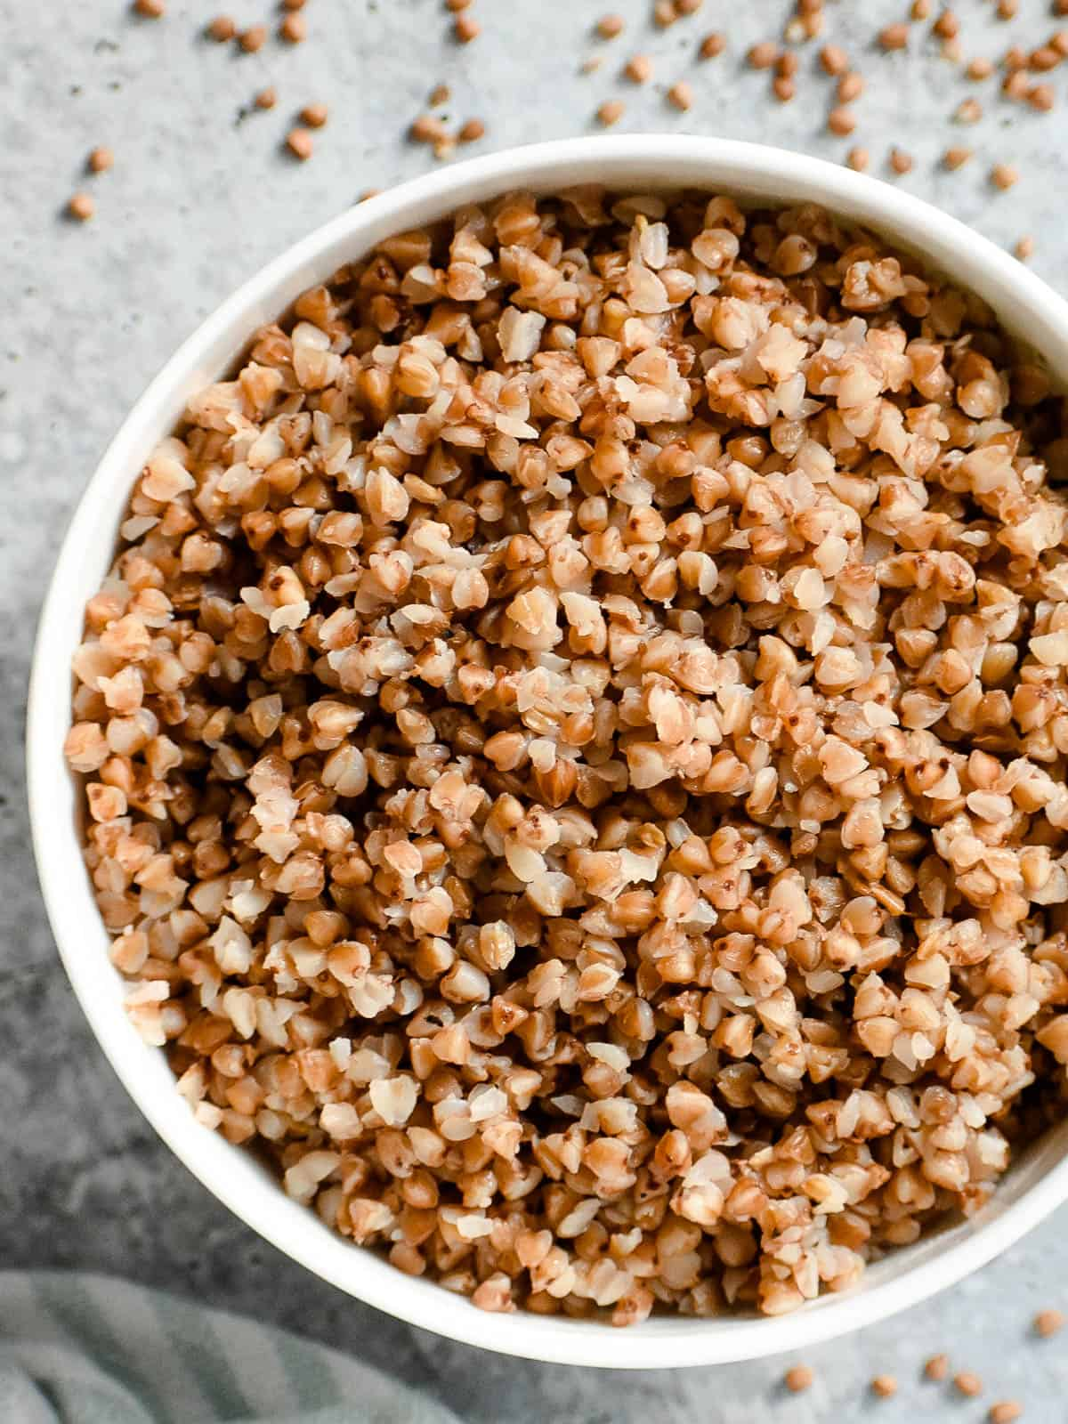
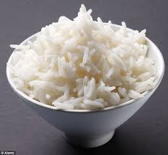
Noodles, rice and other grains - PDF: Page 11
Serve
Do Not Serve
Whole grains (e.g. quinoa, oats, bulgur, buckwheat, barley, farro, whole wheat couscous)
Brown rice, wild rice
Whole wheat or whole grain noodles
White rice (converted, parboiled), rice noodles and enriched white pasta
Flavoured, pre-packaged grains, rice and pasta (e.g. garlic, herb, chicken, vegetable, macaroni and cheese)
2020 Nutrition Guidelines PDF
Notes:
Noodles, rice and other grains found on page 11
Again, select whole grain items and do not serve white rice ( highly prcessed) or flavoured noodles

Slide 13
Protein Foods: Merged Meat and alternatives with Milk Products
This now encompasses the following:
Milk
Milk Alternatives
Yogurt
Cheese
PLUS
Eggs
Nut and Seed
Tofu
Fish
Meat

Slide 14
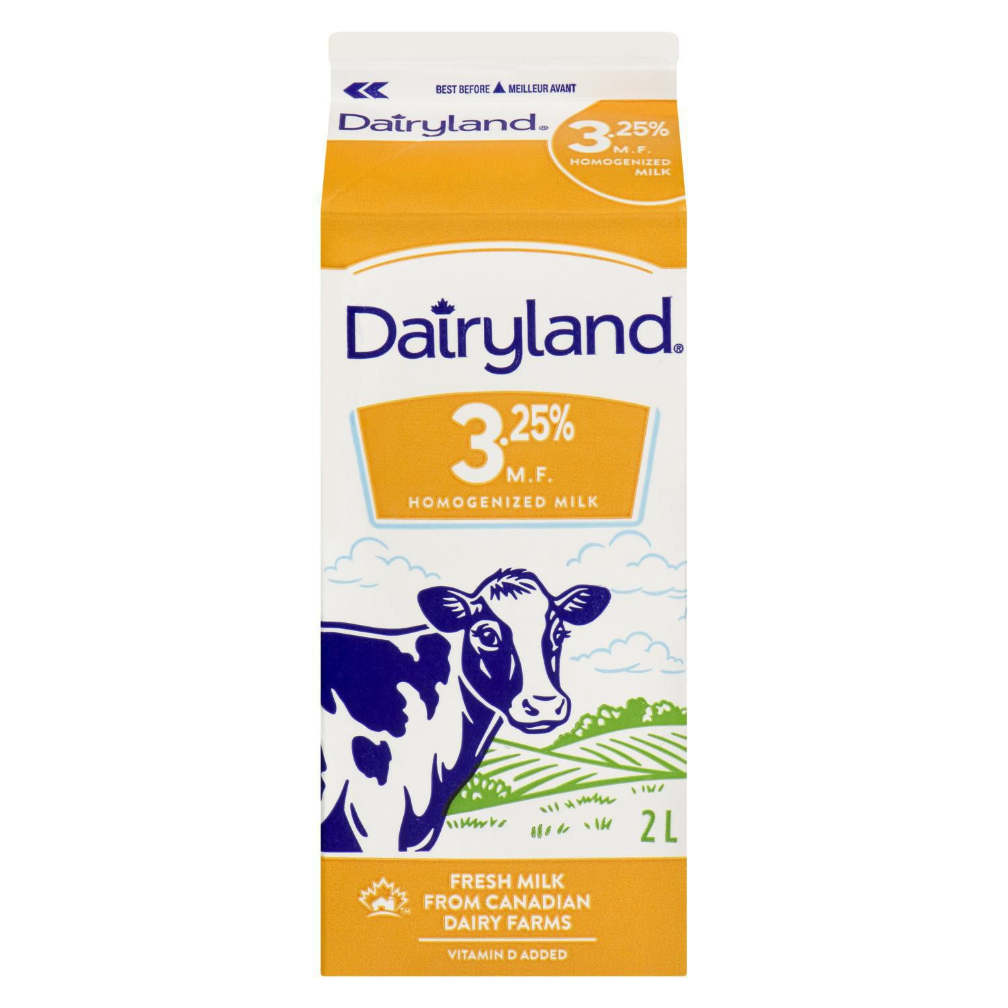
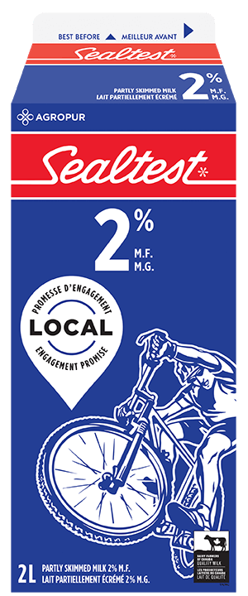
Milk Products- PDF: Page 12
Serve
Do Not Serve
Plain skim, 1%, or 2% cow’s milk Skim milk or partly skimmed milk powder
Canned, evaporated milk, used in cooking and baking
Flavoured milk (e.g. chocolate milk, strawberry milk)
Hot chocolate
3.25% cow’s milk (homogenized milk), table cream, coffee cream, whipping cream, non-dairy whipped cream toppings
2020 Nutrition Guidelines PDF
Notes:
Milk products found on page 12
Serve Plain skim, 1%, or 2%
Canned, evaporated milk, used in cooking and baking is suitable – as its used in smaller amounts
Do not serve flavored milk or hot chocolate as the sugar content tends to be high
Now included in the do not serve section is 3.25% milk as the saturated fat content is higher

Slide 15
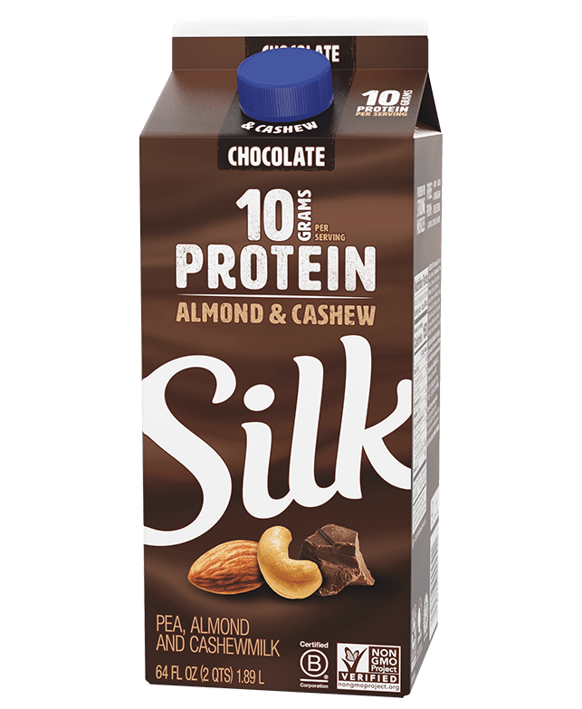
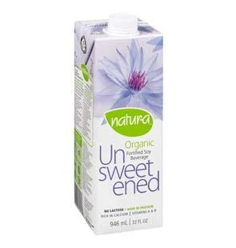
Milk Alternatives- PDF: Page 12
Serve
Do Not Serve
Unsweetened/unflavoured, fortified soy beverage
Unsweetened/unflavoured plant-based beverages with:
at least 6 grams protein per 250 ml
at least 30%DV for calcium
At least 30%DV for vitamin D per 250 ml
Unfortified plant-based beverages
Flavoured/sweetened plant-based beverages
2020 Nutrition Guidelines PDF
Notes:
Serve - Note: Unsweetened plant-based beverages that do not meet the criteria for protein, calcium and vitamin D (e.g. coconut, rice, almond, potato, oat) may be served to accommodate children with allergies ONLY if unsweetened soy beverage (or equivalent) is not an option.

Slide 16
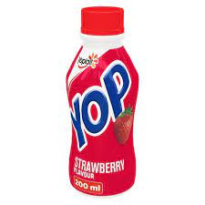
Yogurt- PDF: Page 12
Serve
Do Not Serve
Plain yogurt, soy yogurt and kefir with less than or equal to 2% milk fat
Flavoured/sweetened yogurt, soy yogurt and kefir with:
less than or equal to 11 grams of sugar per 100 gram serving
less than or equal to 2% milk fat
Yogurts with added sugar/candy/chocolate Frozen yogurt
Drinkable yogurt
2020 Nutrition Guidelines PDF

Slide 17
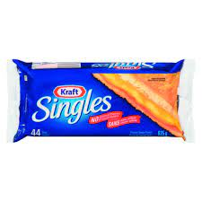
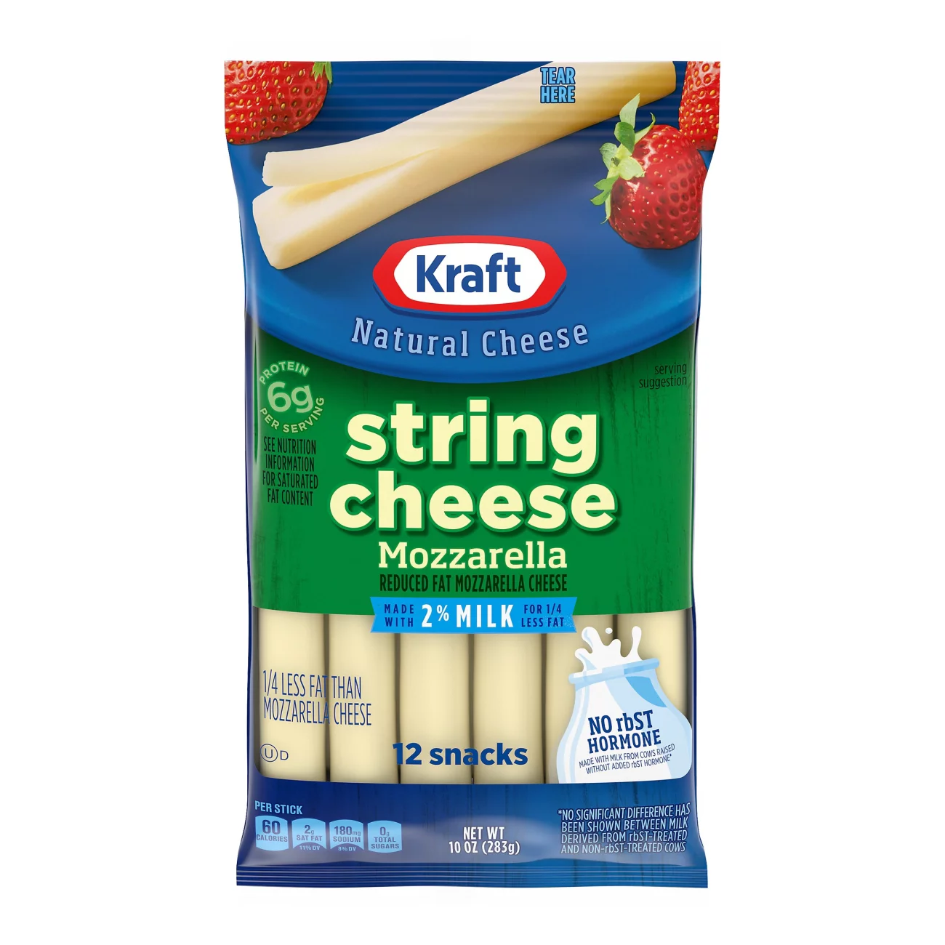
Cheese- PDF: Page 13
Serve
Do not serve
Hard and soft, non-processed cheese made from pasteurized milk with less than or equal to 20% milk fat (when possible)
Cheese sticks, cheese curds with
less than or equal to 20% milk fat (when possible)
less than or equal to 10%DV sodium per serving
Processed cheese slices
Hard and Soft cheeses made from unpasteurized milk
2020 Nutrition Guidelines PDF

Slide 18
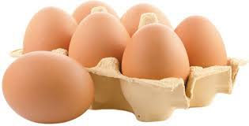
Eggs- PDF: Page 13
Serve
Do Not Serve
Eggs purchased from an approved source (or ‘graded’ eggs)
Plain pasteurized liquid whole egg
Pre-boiled hard cooked eggs
Eggs purchased from an unapproved source (or ungraded eggs)
Unpasteurized, raw or undercooked eggs
Seasoned or flavoured liquid egg product
2020 Nutrition Guidelines PDF

Slide 19
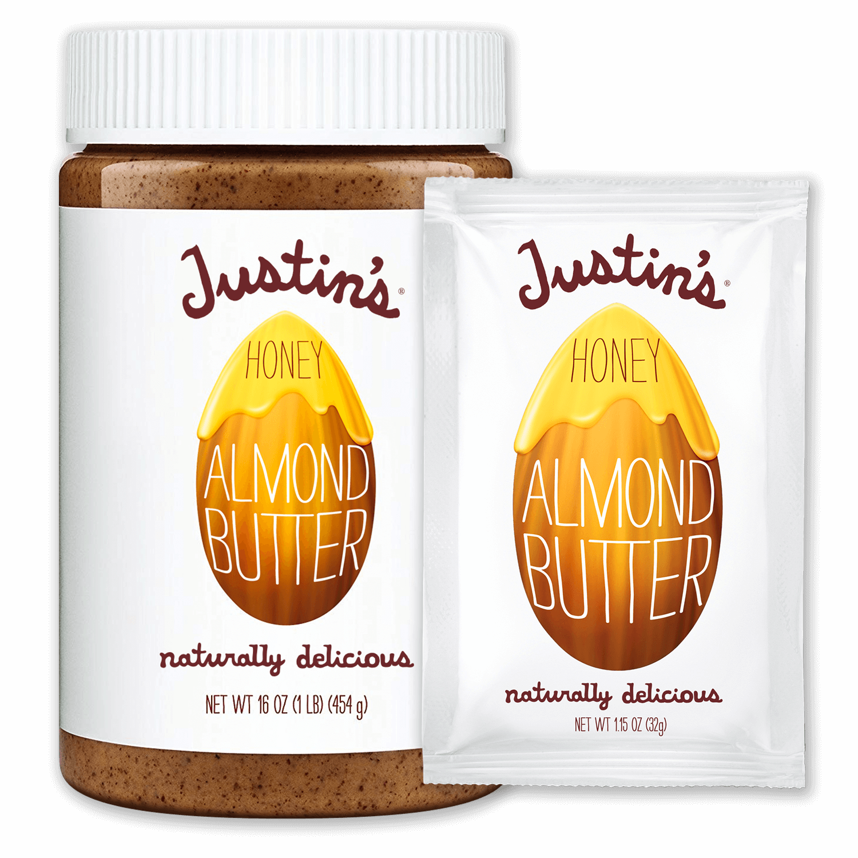
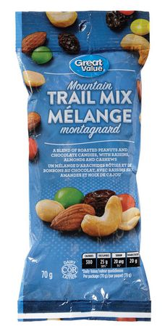
Nut and Seed Butters- PDF: Page 13
Serve
Do Not Serve
Nut, seed and legume butters (including peanut, almond, walnut, sesame, sunflower, pea and soy butters)
Whole nuts and seeds (dry roasted or unroasted, with no added salt, sugar, oil)
Nut, legume or seed butters that have added sugar (e.g. chocolate, chocolate hazelnut, honey, berry)
Salted or coated nuts or seeds
Follow your schools anaphylaxis policy !
2020 Nutrition Guidelines PDF

Slide 20
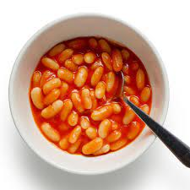
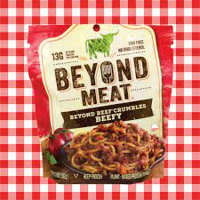
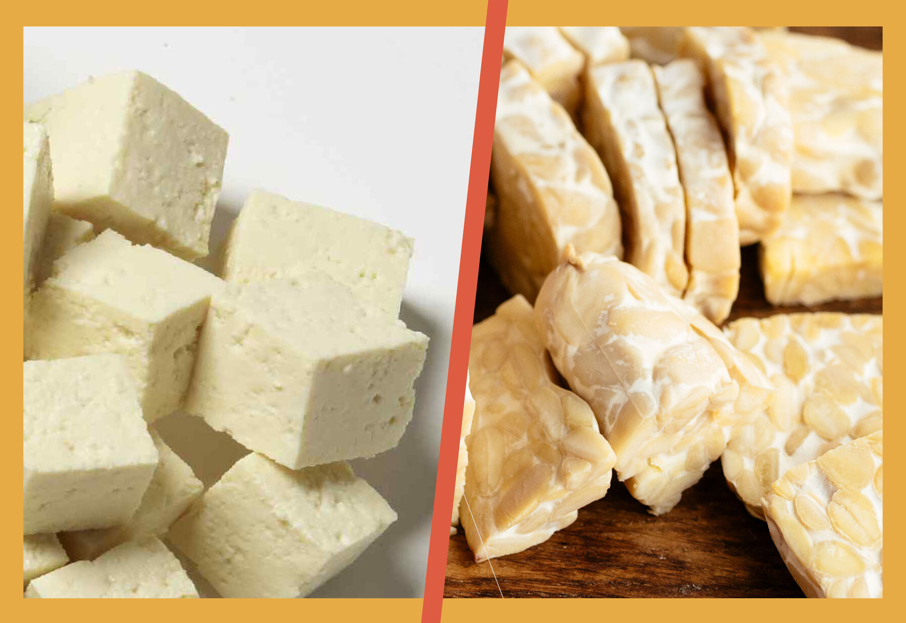
Beans and Legumes- PDF: Page 14
Serve
Do not serve
Any bean, tofu or legume – canned, bean dip, soup or pasta with sodium less than or equal to 10% DV per serving
Canned baked beans, in tomato sauce, with pork, molasses or maple syrup
Store-bought breaded and fried meat alternatives
Simulated meat strips
Plant-based hotdogs, sausages, bacon
2020 Nutrition Guidelines PDF

Slide 21
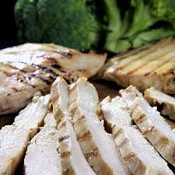
Meat - PDF: Page 14
Serve
Do Not Serve
Fresh, frozen, ground or pre-cooked with less than or equal to 10% DV sodium per serving:
Lean cuts of beef, pork loin, traditional meats and wild game
Patties or meatballs
Skinless chicken and turkey
Pre-cooked chicken/turkey
Prepared/cured meats (e.g. wieners/hotdogs, sausages, pepperoni sticks)
Deli meats
Ham, Ribs, Side bacon, back bacon, turkey/chicken, bacon, imitation bacon bits
Meat pies
2020 Nutrition Guidelines PDF

Slide 22
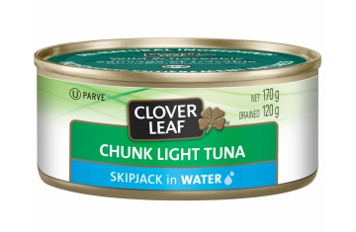
Fish- PDF: Page 14
Serve
Do not serve
Fresh, frozen, or canned fish with
less than or equal to 10% DV sodium per serving,
drained and rinsed to lower sodium content further, and low in mercury (e.g. cod, sole, haddock, salmon, tilapia, trout, canned light tuna, whitefish)
Store-bought breaded or battered fried fish
Fresh, frozen or canned fish high in mercury (e.g. canned albacore tuna)
Cold smoked fish
2020 Nutrition Guidelines PDF

Slide 23
Miscellaneous items not to be served
These foods and beverages contain few or no essential nutrients, and/or contain high amounts of added salt, sugar or unhealthy fats
Do not serve:
Food and beverages containing caffeine such as coffee, tea and iced tea
Diet and regular pop, Energy drinks or sports drinks, Flavoured or vitamin water
‘Protein’ or meal replacement drinks and bars (except when indicated by a parent/caregiver for medical reasons)
Candy (including yogurt covered, gummy-type, licorice, fruit flavoured)
Hard margarines • Lard or shortening
Foods with sugar substitutes or sweeteners
2020 Nutrition Guidelines PDF
Notes:
These foods and beverages contain few or no essential nutrients, and/or contain high amounts of added salt, sugar or unhealthy fats
The points listed here are examples of these.

Slide 24
Minor ingredients
The following items can be used in small amounts (as indicated in PDF link ) and served on the side, when necessary, or used in the preparation of mixed dishes
Condiments
Gravies, sauce, dips
Oils, non-hydrogenated margarines, dressings, mayonnaise
Toppings and extras e.g. coconut or pickles
Honey, jam, jelly, marmalade, fruit butter, or syrup
2020 Nutrition Guidelines PDF
Notes:
Minor ingredients are items that can be used in small amounts (as indicated in PDF link ) and served on the side, when necessary, or used in the preparation of mixed dishes

Slide 25
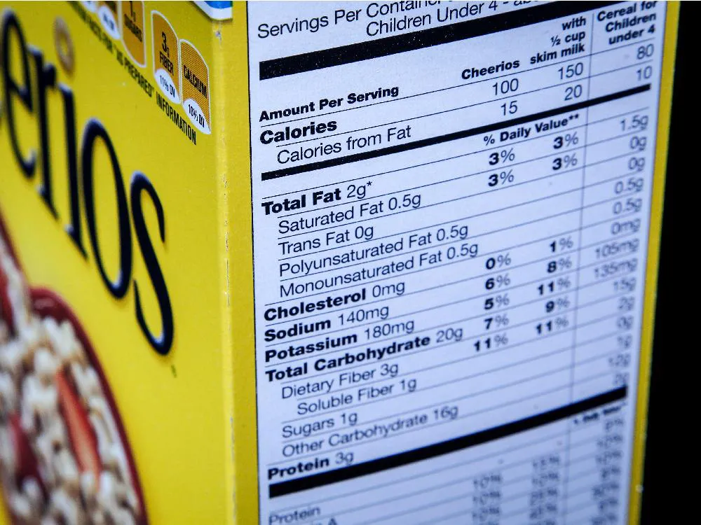
End of Module 3
Thank you

