Slide 1
OSNP Guideline Changes : Module 9 Sample Menus
https://nutritionconnections.ca/wp-content/uploads/2020/09/SNP-Nutrition-Guidelines-2020.pdf

Slide 2
Menu planning checklist
Notes:
This menu planning checklist is a great resource to get prepared for the type of program your school will be implementing, weather you are serving a snack on the go or a sit down meal such as breakfast.
The following slides are examples of how to select foods that meet the student nutrition guidelines
These are a reference only, feel free to develop your own unique menu for your program !

Slide 3
Grab and Go Ideas

Slide 4
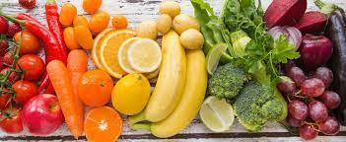
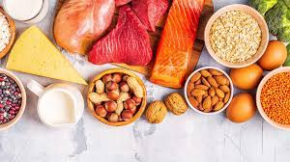
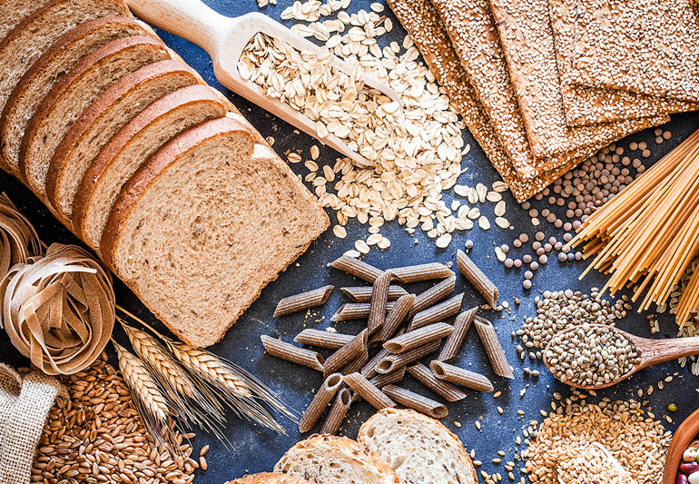
Grab and go meal menu
+
+

Slide 5
Grab and go snack menu
+
OR

Slide 6
Morning Meal Menu (sit down)
For more examples please refer to 2020 Nutrition guidelines Section 9.

Slide 7
Snack Menu (sit down)
For more examples please refer to 2020 Nutrition guidelines Section 9.

Slide 8
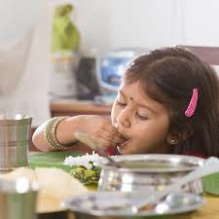
End of Module 9
2020 Student Nutrition Guidelines

